Slide 1
Data-Driven Insights for Responsible Lending and Customer Retention in Fintech
Presented by: Olawale Odofin
Email: olawaleodofin51@gmail.com
Date: 29/12/2024

Slide 2
Outline
Problem Statement
Objectives
Dataset Overview
Data Modeling
Feature Engineering
Dashboard
Key Insights
Recommendations
Conclusion

Slide 3
Problem Statement
The fintech and banking sectors face significant challenges with customer churn and high risks associated with loan approvals. This project was initiated to address these issues by leveraging data-driven insights to optimize loan approval processes and minimize risks. By analyzing customer profiles, the project aimed to ensure loans are offered only to eligible customers and tailored to their financial capacity, social behavior, and demographic characteristics.

Slide 4
Objectives
To analyze customer financial profiles and recommend suitable loan class based on eligiblity criteria, social media engagement, and demographic characteristics of customers.

Slide 5
Dataset Overview
The dataset contained detailed information of 150 customers, captured across five tables:
Fact_Social_Media_Engagement: Tracks customers' online activities to evaluate engagement levels.
Fact_Transactions: Captures customers' transaction patterns and behaviors.
Dim_Customers: Contains customer demographics and socioeconomic attributes.
Dim_Date: Provides a timeline for analysis, linking transactional and engagement data.
Dim_Transaction_Types: Categorizes customer transactions into types.

Slide 6
Data Modeling
Star schema modeling design was used to connect the fact tables to dimension tables via primary and foreign keys, enabling multidimensional analysis. Dim_Customers table served as the primary hub for understanding customer demographics and behaviors. Relationships were established between social media, transaction, and demographic data tables, enabling seamless integration of insights.

Slide 7
Feature Engineering
Feature engineering played a pivotal role in calculating customer social media engagement score, and customer credit score.
Social media engagement score was calculated by dividing engagement by impressions to gauge customer influence.
Credit score was derived from demographic, transactional, and engagement data of the customer with a scoring system ranging from 0 to 30. Customers were categorized into high, medium, and low creditworthiness levels, forming the basis for loan eligibility decisions.
High (>= 22): Eligible for loans.
Medium (15–21): Not eligible.
Low (Below 15): Not eligible.

Slide 8
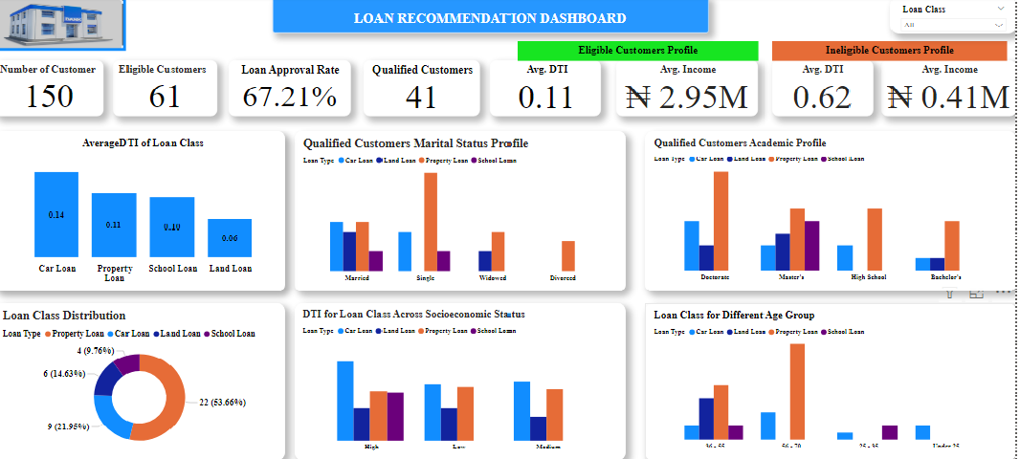

Slide 9
Key Insights: Customers Distribution and Eligibility
Out of 150 customers, only 61 met the eligibility criteria.
Out of the 61 eligible customers, only 41 are qualified for loan resulting in a 67.21% loan approval rate.
Eligible customers had an average Debt-To-Income ratio of 0.11, compared to 0.62 for ineligible customers.
Eligible cusstomers had an average income of ₦2.95M, far higher than unqualified customers’ avaerage income of ₦0.41M.
This emphaszied the importance of Debt-To-Income (DTI) in assessing loan eligiblity, and the role of income in credit risk assessment.

Slide 10
Loan Class Distribution Among Qualified Customers
Property loan is the most popular among the qualified customers, followed by car loan and Land loan . School loans is the least among the customers.
The dominance of property loans indicates strong demand for high - value financial support, suggesting that customers have sufficient creditworthiness to manage large loan.
Fintech companies and Banks should focus on promoting property loans and ensuring they align with customers needs.

Slide 11
Average DTI of Loan Class
Loan class - specific average DTI values:
Car loan: 0.14
Property loan: 0.11
School loan: 0.10
Land loan: 0.06
This low DTI across the loan class shows that qualified customers have sufficient financial capacity to take loan and make repayment without default risk.

Slide 12
Qualified Customers Marital Status Profile
Married customers dominated loan eligibilty, indicating financial stability among this group.
single customers shows a fair share, while the widowed and divorced customers have relatively lower representation.
Marital status plays a role in financial risk, with married customers often perceived as more stable.

Slide 13
Qualified Customers Academic Profile
All the academic qualification are more inclined toward property loans with Doctorates degree having the highest number of qualified customers followed by Master’s degree.
Customers with Doctorates are more qualified for Car loan
Customers with Master’s degree are more qualified for school loan and land loan.
This revealed how academic background impacts financial behaviour and preferences of customers.

Slide 14
DTI for Loan Class Across Socioeconomic Status
Customers with High socioeconomic status are qualified for all the loan class than other socioeconomic status with maneageble DTI.
Customers with Medium, and Low socioeconomic status are not qualified for school loan.
This reveals that socioeconomic status significantly impacts financial health and eligibility, enabling targeted marketing efforts to high - potential customers.

Slide 15
Loan Class for Different Age Group
Customers within the age group 36 - 55 years are qualified for loans across all clasess.
Customers within the age group 56 - 70 years are qualified for Property loan and Car loan.
Younger customers (under 25 years0 and customers within the age group 25 - 35 years have minimal representation.
This highlights that mid - aged customers are the primary loan candidates.

Slide 16
Recommendations
Targeted Lending Strategies: Focus should be on customers with high - credit scores, low DTI ratios, within the age group 36 - 55 years, particularly with high socioeconomic status to minimize default risks.
Custom Loan Offerings: Tailor loan offers to specific demographics and financial profiles, such as property loans for middle - income families and school loans for younger individuals. Leverage academic qualifications in segmentation to attract customers with Bachelor’s or higher degrees.
Personalized Engagement: Leverage social media insights to create personalized loan offers. Bulid customer engagement program to nurture relationships with high-creditcustomers.
Educational Outreach: Provide financial literacy programs to the ineligible customers to improve their financial management and eventual eligibility.

Slide 17
Conclusion
This project successfully demonstrated the value of data - driven decisions in optimizing loan approval and reducing risk. By focusing on customer creditworthiness, demographic trends, and social behaviours, fintech companies and banks can ensure responsible lending while enhancing customer satisfaction and loyalty.
The insights and recommendations derived from this analysis provide a roadmap for implementing scalable and efficient laon approval processes.

Slide 18
Thank You

